Slide 1
Cyclops Project
Data Science Division, Statistics Canada
Presentation 5 – December 2, 2019

Slide 2
Pipeline and Status Update
Image
OCR
Fuzzy matching to correct the output of the OCR
User interface
Compliance Assessment (ingredients, claims)
Classification of the corrected words to category: claims, ingredients, product names, company names, NPN
API Calls
(LNHPD API)
User checks OCR result
Completed
Will be done soon
Pending

Slide 3
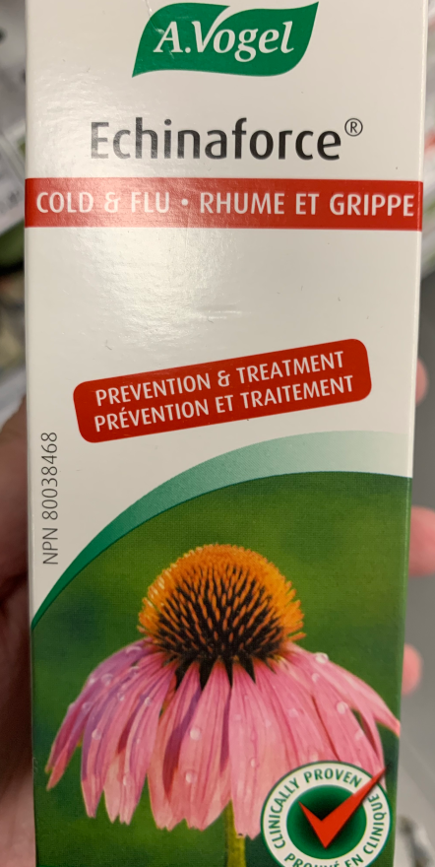
Update on OCR
Company Name
Classification
Human Annotation
Detect and recognize text
Fuzzy matching
Classification to a Type
Annotate image area to a type
Recognize text inside each area
NPN

Slide 4
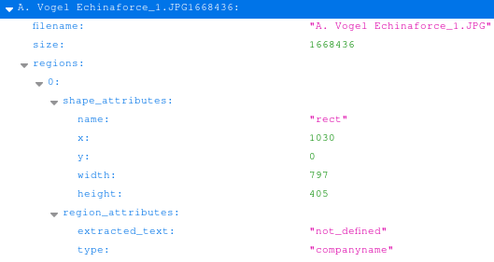
Annotated areas are save in JSON
Annotation JSON

Slide 5
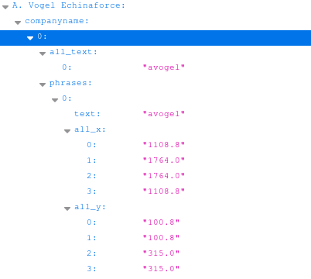
Extract text in the area
to serve as test data
OCR of Annotation JSON

Slide 6
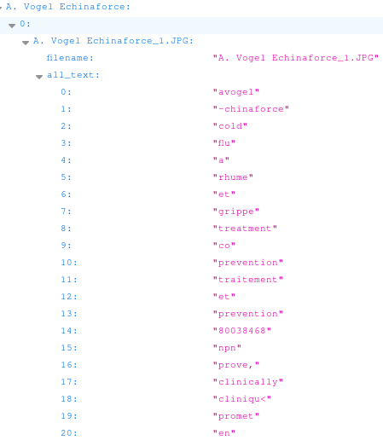
Recognize the text for each type
Raw OCR of Image
Which text in the OCR dump is the Company Name?

Slide 7
Next Step (by end of December)
DScD:
Fuzzy matching: OCR vs. Annotation comparison
Ingredient Alternate Name finder (synonym)
HC
Ingredient database
Cloud Environment
Update on border service images and annotations

Slide 8
Thank you!

